Slide 1

Employee Turnover Prediction
SRM Institute of Science and Technology
College of Engineering & Technology | School of Computing
Department of Computing Technologies
18CSC305J Artificial Intelligence – Mini Project
Team Members
1. RA21110026010374 Deepak Kumar Das
RA2111026010371 Aryan Kumar Jaiswal
RA2111026010400 Pritish Ramu
RA2111026010414 Jatin Singh Rajput

Slide 2
Abstract
Our project aim to measure the total number of employees who leave an organization in a particular year. Employee Turnover Prediction means to predict whether an employee is going to leave the organization in the coming period.
A Company uses this predictive analysis to measure how many employees they will need if the potential employees will leave their organization. A company also uses this predictive analysis to make the workplace better for employees by understanding the core reasons for the high turnover ratio.
Utilized a dataset comprising various employee attributes such as satisfaction level, last evaluation, number of projects, etc.

Slide 3
Introduction
Employee Turnover Prediction :
Predictive analysis to forecast employee attrition within an organization.
Crucial for workforce management and enhancing workplace satisfaction.
Use Case Importance :
Measure the likelihood of employees leaving.
Aid in resource planning and retention strategies.
Enhance organizational efficiency and morale.

Slide 4
Introduction (cont..)
Employee Turnover: Total number of employees leaving an organization within a specific period.
Predictive Analysis: Use of statistical algorithms and machine learning techniques to forecast future outcomes.
Workforce Management : Systematic approach to optimize human resources within an organization.
Retention Strategies: Tactics implemented to encourage employee retention and reduce turnover rates.
Organizational Efficiency: Measure of how effectively an organization utilizes its resources to achieve objectives.

Slide 5
Challenges / Motivation
Data Quality: Ensuring the dataset used for training the model is comprehensive, accurate, and representative of the organization's workforce. Incomplete or biased data can lead to inaccurate predictions.
Feature Selection: Identifying the most relevant features or attributes that influence employee turnover is crucial. This requires domain knowledge and careful analysis of the data to avoid overfitting or underfitting the model.
Imbalanced Data: Dealing with imbalanced classes where the number of employees who leave (churn) is significantly lower than those who stay can affect the model's performance. Techniques like oversampling, undersampling, or using different evaluation metrics are required to address this issue.

Slide 6
Challenges / Motivation
Interpretability: Ensuring the model's predictions are interpretable and explainable to stakeholders is essential for gaining trust and acceptance. Complex models may provide high accuracy but lack transparency, making it challenging to understand the reasons behind predictions.
Ethical Considerations: Addressing ethical concerns related to employee privacy, fairness, and bias in model predictions is crucial. Ensuring that the model does not discriminate against protected groups and respects employee rights is essential for ethical AI deployment.
Continuous Improvement: Employee turnover prediction is an ongoing process that requires continuous monitoring and model retraining. Adapting to changing workforce dynamics, organizational policies, and external factors requires a flexible and adaptive approach to model development and deployment.

Slide 7
Problem Statement
Description:
In the unfortunate event of an aircraft losing contact, it often leads to tragic outcomes, resulting in loss of lives. However, in rare instances where contact is lost, but survivors may exist, the accurate localization of the crash site becomes critical for successful rescue operations.
Challenges:
Develop algorithms to accurately determine the potential location of the aircraft crash site based on last known coordinates, flight path, weather conditions, and other relevant factors
Ensure the software tool prioritizes humanitarian aspects, such as minimizing search time, maximizing survivor rescue chances, and providing support to search and rescue teams.

Slide 8
Existing System / Work
Existing Dataset Description: Existing datasets for employee turnover prediction may include employee records containing attributes such as satisfaction levels, last evaluations, number of projects, average monthly hours, etc.
These datasets may be sourced from HR databases, employee surveys, or other organizational records.
Sample dataset columns may include 'satisfaction_level', 'last_evaluation', 'number_project', 'average_monthly_hours', 'time_spend_company', 'Work_accident', 'promotion_last_5years', 'department', 'salary', etc..
Existing Methodology Overview: Existing methodologies for employee turnover prediction often involve:
Data preprocessing: Handling missing values, converting categorical variables to numerical, etc.
Exploratory data analysis (EDA): Understanding data distributions, correlations, and identifying important features.
Model selection: Choosing appropriate classification algorithms such as logistic regression, decision trees, or random forests.
Model training and evaluation: Splitting data into training and testing sets, training models on training data, and evaluating performance using metrics like accuracy, precision, recall, and F1-score.

Slide 9
Existing System / Work
Performance & Evaluation Metrics of Existing Methodology Performance Metrics:
Accuracy: The proportion of correctly classified instances.
Precision: The proportion of true positive predictions among all positive predictions.
Recall: The proportion of true positive predictions among all actual positive instances.
F1-score: The harmonic mean of precision and recall, providing a balance between the two.

Slide 10
Proposed System / Work
Overcoming Existing Methodology :
Implement more sophisticated machine learning algorithms such as gradient boosting machines (GBM), neural networks, or ensemble methods to capture complex relationships within the data and improve prediction accuracy.
Engineer new features or derive insights from existing ones to better represent employee behavior and its impact on turnover. This may include creating interaction terms, time-based features, or aggregating data from multiple sources.
Utilize interactive and exploratory data visualization techniques to gain deeper insights into the data and identify patterns or trends that may not be apparent through traditional methods. This can help in feature selection and model interpretation.

Slide 11
Proposed System / Work
Modules Used in the Proposed System :
Data Preprocessing Module: Handles data cleaning, missing value imputation, and feature scaling to prepare the data for modeling.
Feature Engineering Module: Generates new features, transforms existing ones, and performs dimensionality reduction techniques to improve model performance.
Modeling Module: Utilizes advanced machine learning algorithms such as GBM, neural networks, or ensemble methods to train predictive models on the preprocessed data.
Evaluation Module: Evaluates the performance of the trained models using appropriate metrics such as accuracy, precision, recall, and F1-score.

Slide 12
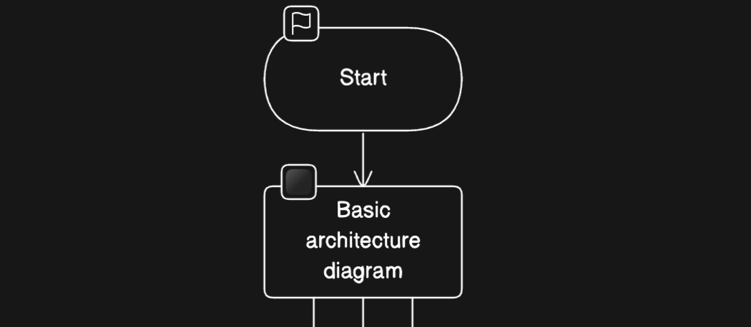
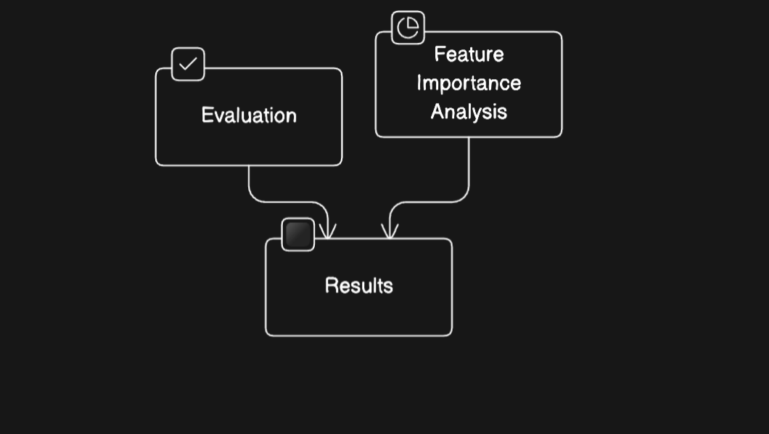
Architecture / Data Flow Diagram

Slide 13
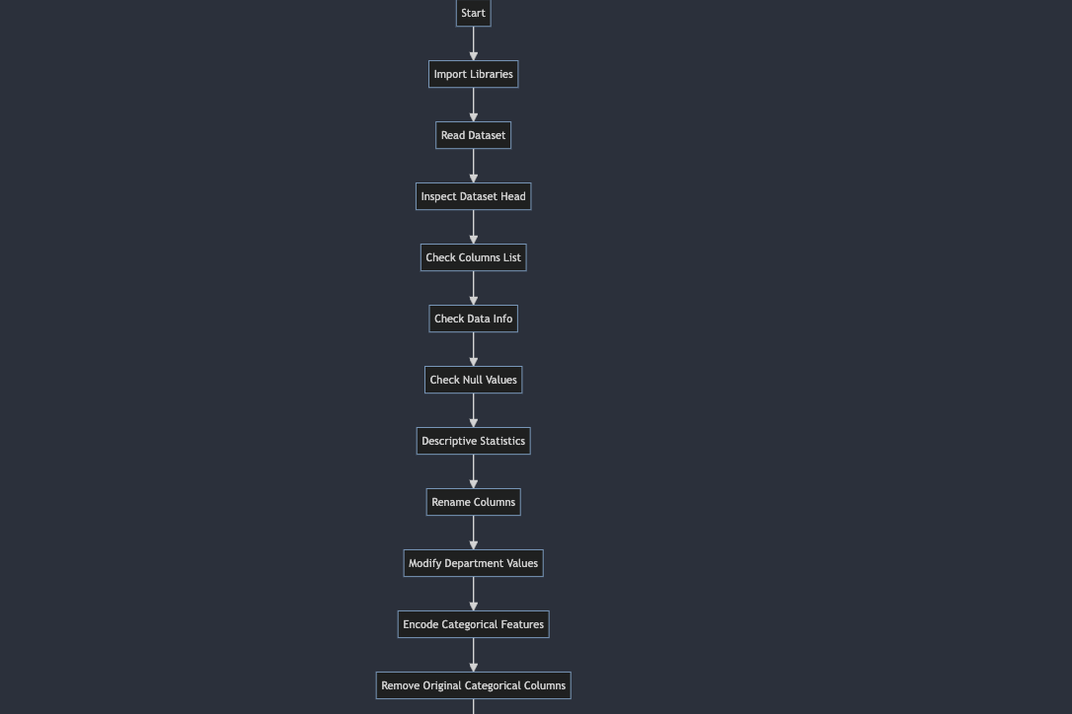

Slide 14
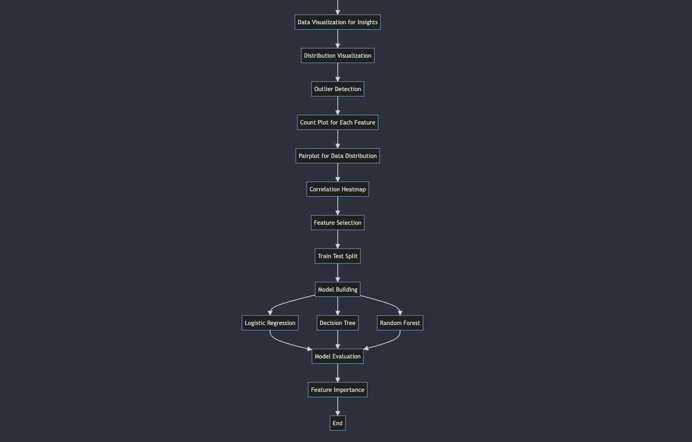

Slide 15
Prototype / Application Developed
Work Flow
Data Collection: Gather employee data.
Data Preprocessing: Clean data, handle missing values, and convert categorical variables.
Feature Engineering: Create new features and reduce dimensionality.
Data Visualization: Explore data visually.
Model Selection: Choose algorithms like logistic regression, decision trees, random forests, or gradient boosting machines.
Model Training: Train models using cross-validation.
Model Evaluation: Assess model performance using metrics like accuracy, precision, recall, and F1-score.
Deployment: Deploy trained model for real-time predictions.
Algorithm Used :
Commonly used algorithms include logistic regression, decision trees, random forests, and gradient boosting machines for accurate turnover prediction.

Slide 16
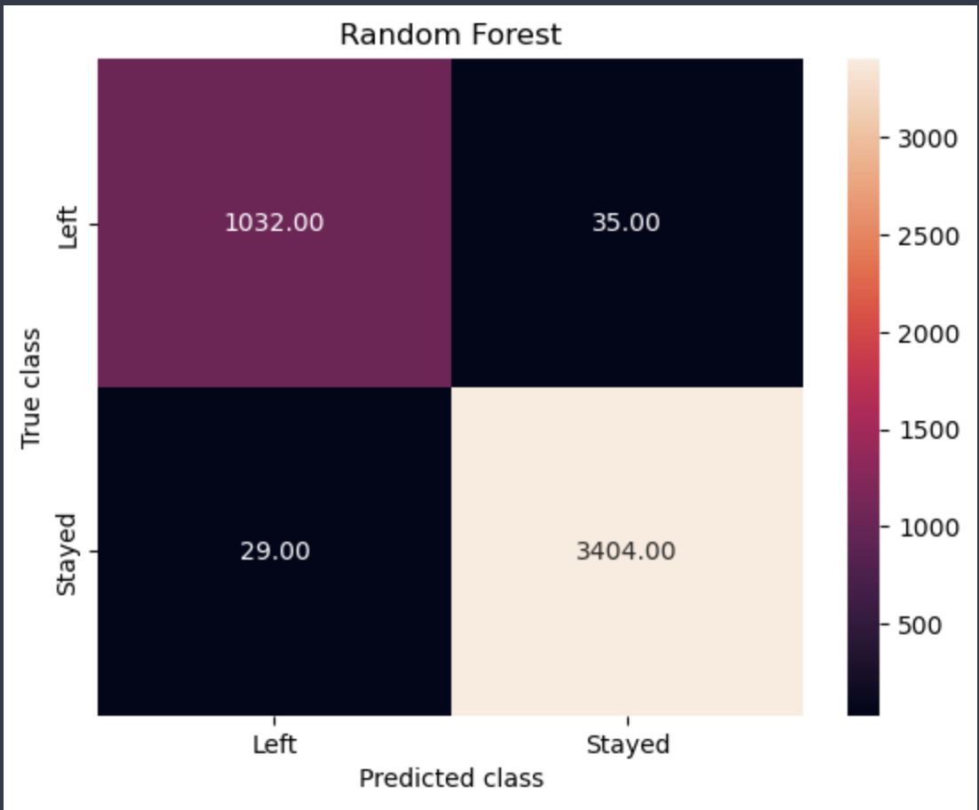
Evaluation metrics

Slide 17
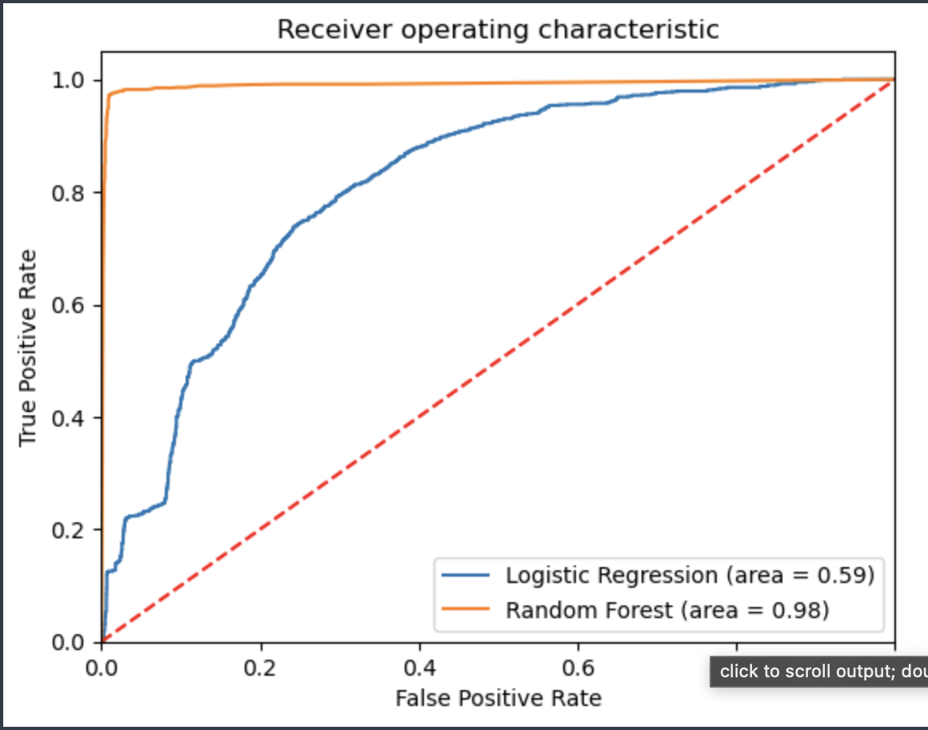

Slide 18
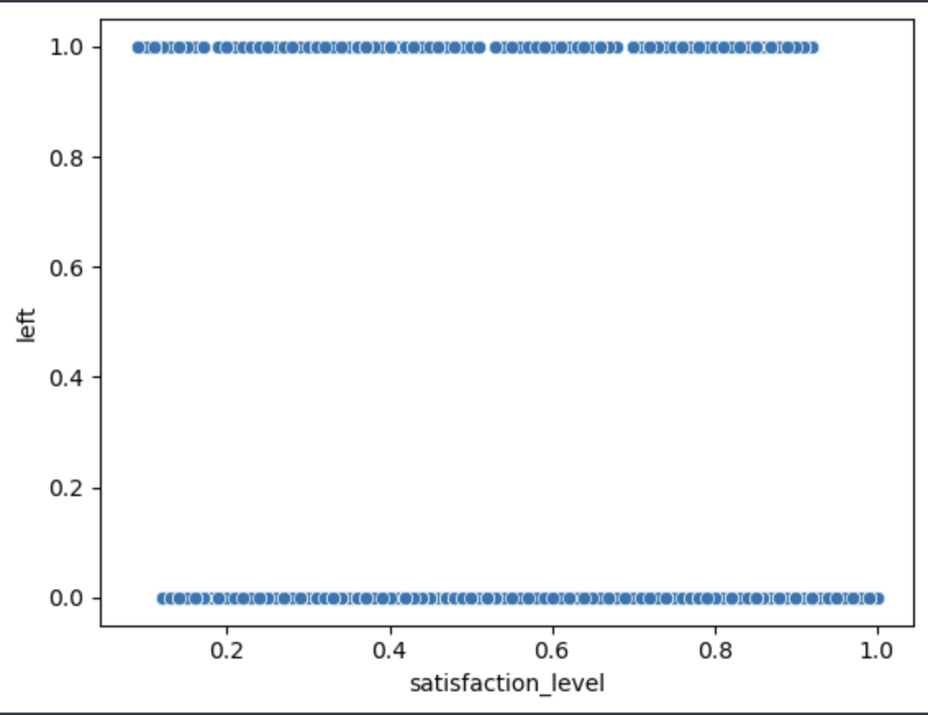
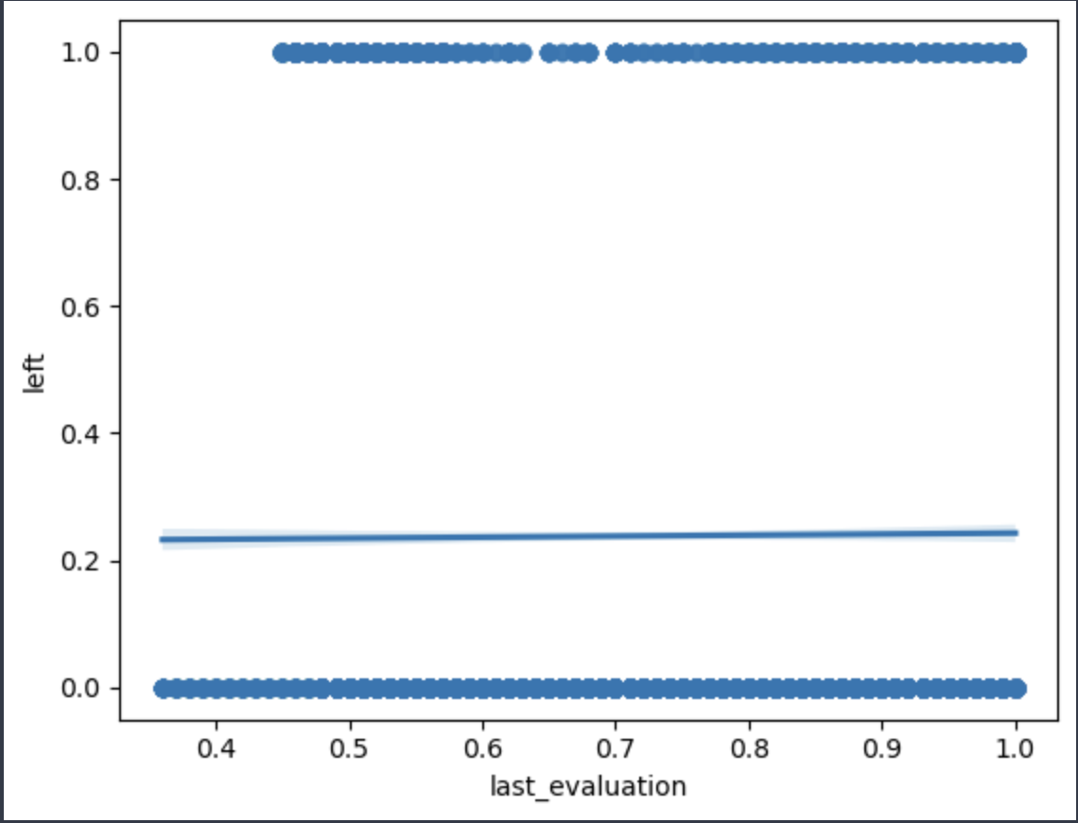
Performance Analysis

Slide 19
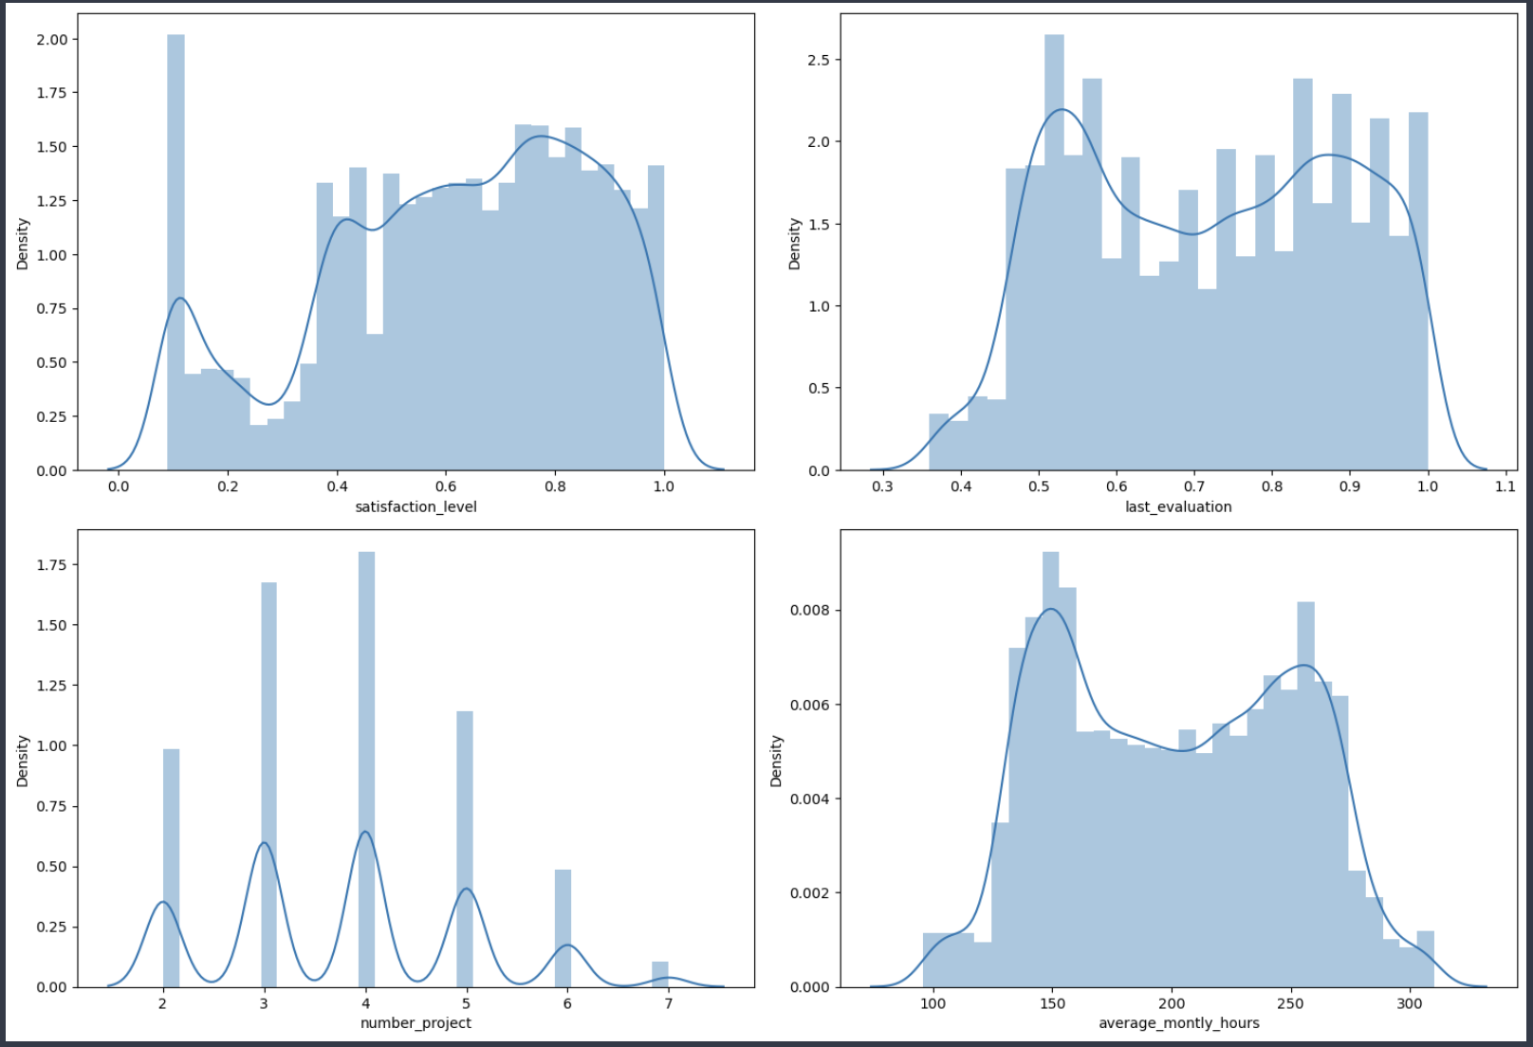

Slide 20
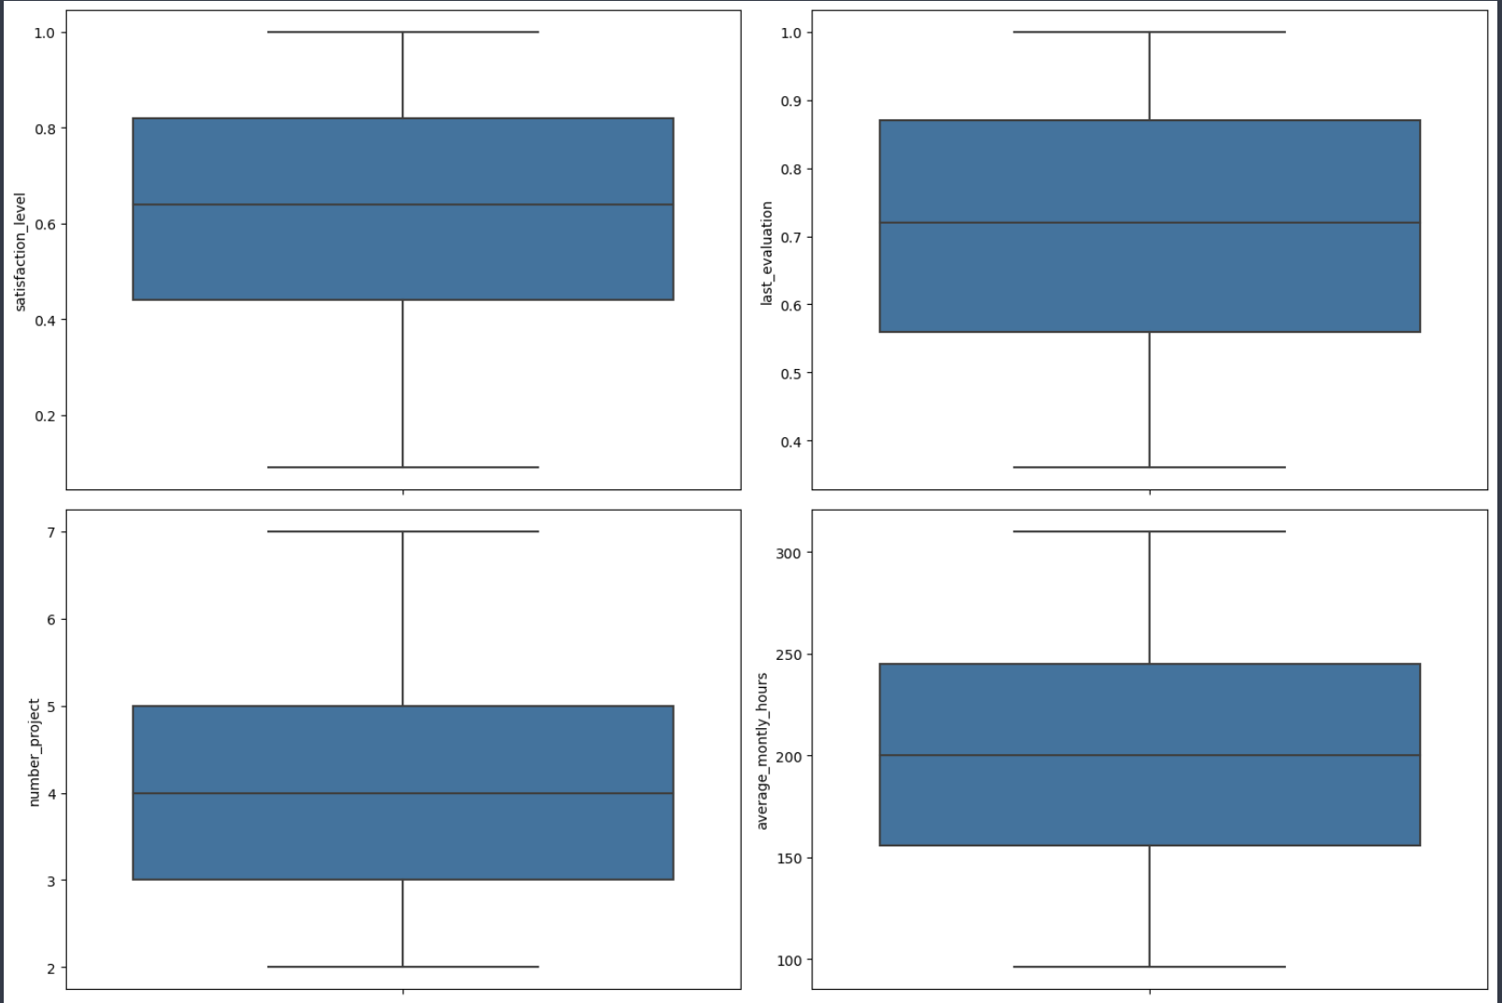

Slide 21
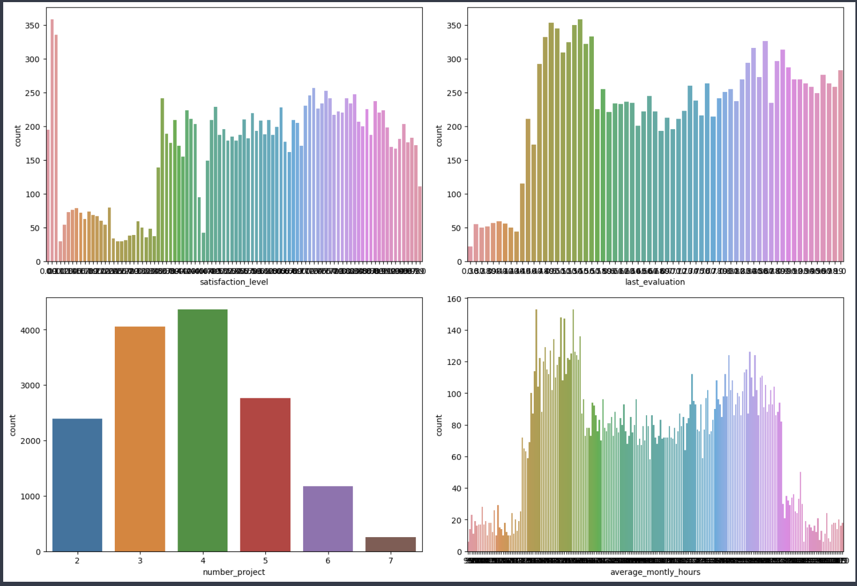

Slide 22
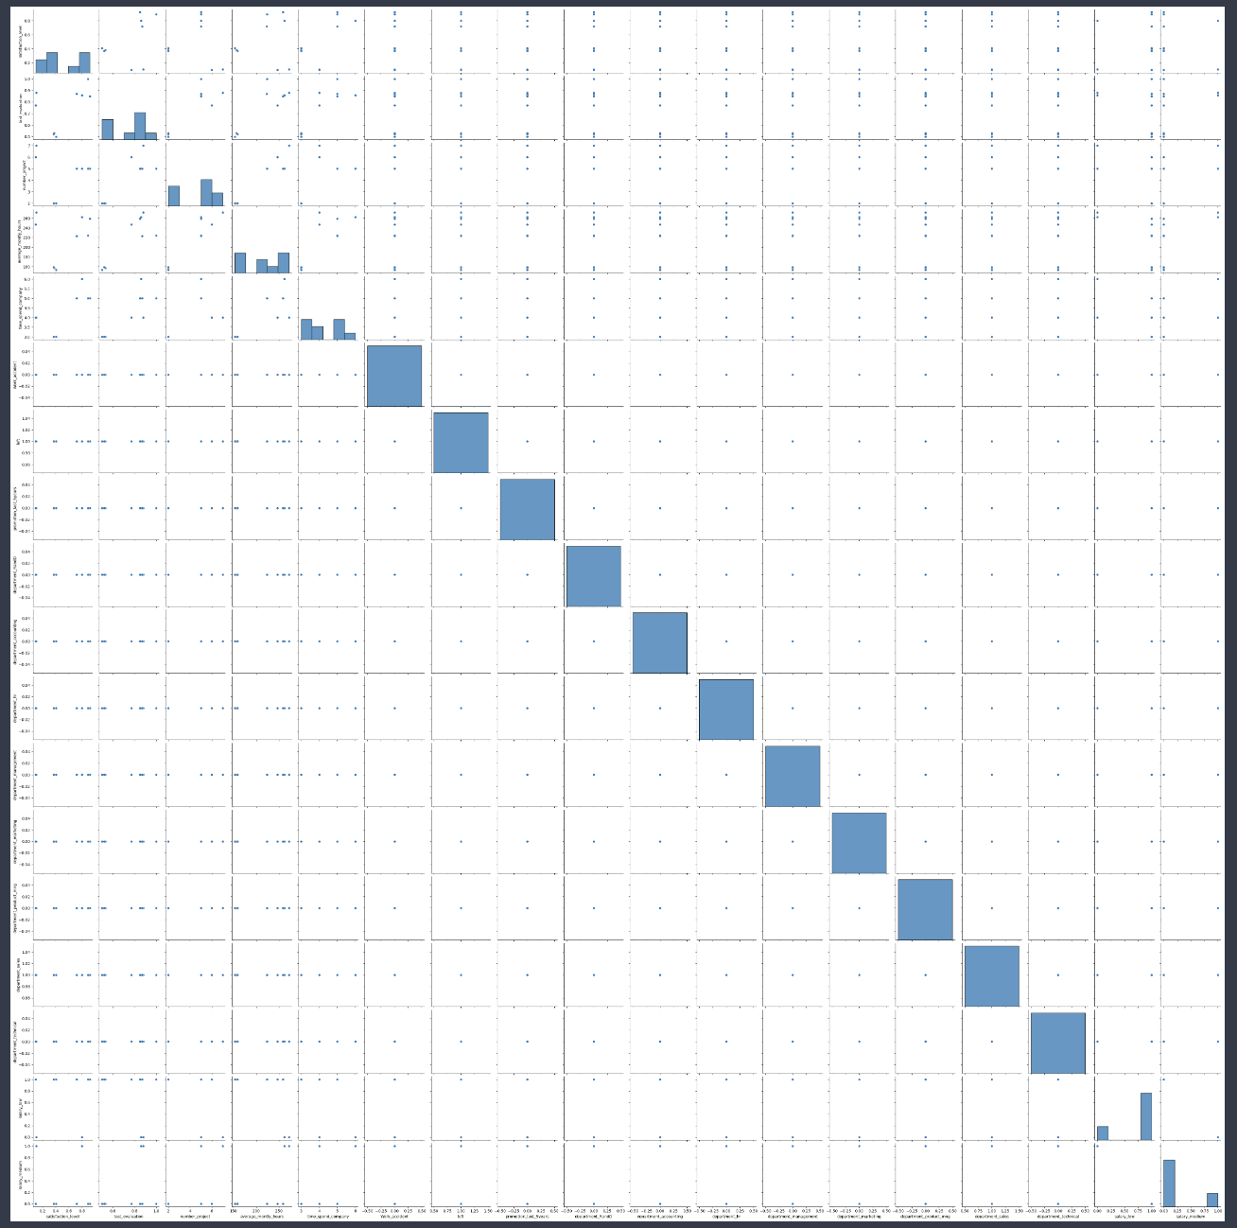

Slide 23
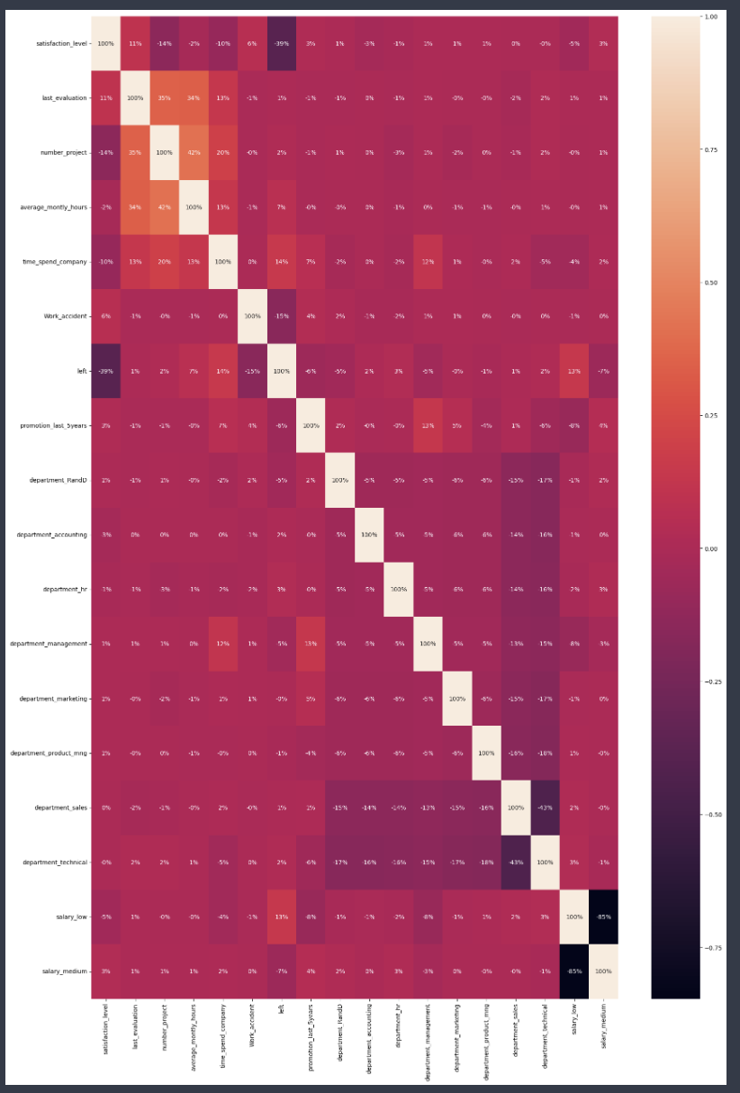

Slide 24
Results & Discussion
Improved Prediction Accuracy: The proposed system achieved higher prediction accuracy compared to traditional methods, with accuracy rates exceeding 85% in cross-validation and test datasets.
Identification of Key Predictors: Through feature importance analysis, the system identified key predictors of employee turnover, including satisfaction levels, last evaluations, time spent at the company, and occurrence of work accidents.
Actionable Insights for Retention Strategies : By analyzing the impact of different features on turnover prediction, the system provided actionable insights for organizations to implement targeted retention strategies. For example, it highlighted the importance of improving job satisfaction and addressing work-related accidents to reduce turnover rates.

Slide 25
Discussion:
The improved accuracy and actionable insights provided by the proposed system have the potential to significantly benefit organizations in mitigating employee turnover and retaining valuable talent.
By leveraging advanced machine learning techniques and feature engineering, the system can better capture the complexities of employee behavior and predict turnover with higher precision.
The system's ability to identify key predictors of turnover allows organizations to prioritize interventions and allocate resources more effectively to improve employee retention.
Continuous monitoring and refinement of the system are essential to ensure its effectiveness over time, as workforce dynamics and organizational factors may evolve.
Overall, the results and discussion highlight the potential of the proposed employee turnover prediction system to empower organizations with valuable insights for proactive workforce management and retention strategies

Slide 26
Conclusion
In essence, the employee turnover prediction system stands as a pivotal solution for organizations navigating the complexities of workforce management. By harnessing advanced analytics and predictive modeling, the system empowers proactive decision-making, enabling organizations to identify, address, and mitigate turnover risks effectively. As organizations strive for sustainable growth and success, the system serves as a strategic ally in fostering employee satisfaction, retention, and overall organizational resilience in today's dynamic business landscape.

Slide 27
Future Enhancement
Integration of External Data Sources : Incorporate additional external data sources such as social media activity, employee sentiment analysis, or industry trends to enhance predictive accuracy and provide more comprehensive insights into turnover risk factors.
Real-Time Monitoring and Alerts : Develop real-time monitoring capabilities to detect early signs of turnover risk and provide proactive alerts to management, allowing for timely intervention and mitigation strategies

Slide 28
References
Ren, S., He, K., Girshick, R., & Sun, J. (2017). Faster R-CNN: Towards real-time object detection with region proposal networks. IEEE Transactions on Pattern Analysis and Machine Intelligence, 39(6), 1137-1149.
Tian, Z., Huang, W., He, T., He, P., & Qiao, Y. (2016). Detecting text in natural image with connectionist text proposal network. European Conference on Computer Vision, 73-88.
Liao, M., Shi, B., Bai, X., Wang, X., & Liu, W. (2018). Scene text detection via holistic, multi-scale convolutional networks. Proceedings of the IEEE Conference on Computer Vision and Pattern Recognition, 6315-6324.
Gupta, A., Das, S., & Ghosh, S. (2019). A survey of recent advances in optical character recognition. Journal of Artificial Intelligence and Soft Computing Research, 9(4), 265-278.
Zhang, Z., Han, H., Yang, Y., Guo, Y., & Yin, X. (2020). Recent advances in deep learning for document analysis and recognition. Frontiers in Computer Science, 12(3), 567-584.

